Slide 1

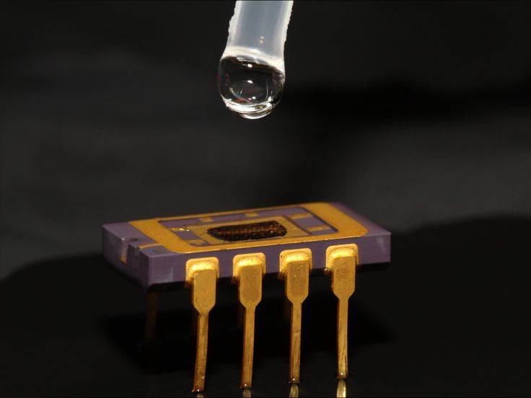
Chemical Sensors
Biology for Engineers - Group Presentation
Presented by :
Arav, Eshika, Areeb, Mohammed, Omkar

Slide 2
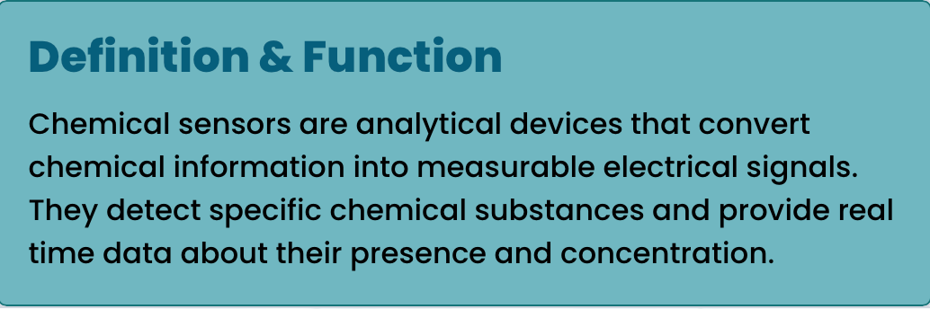
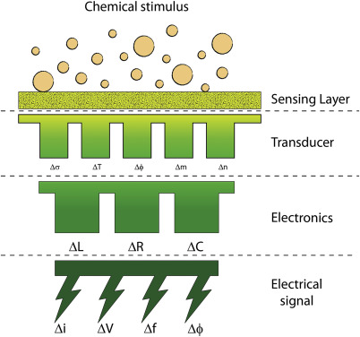


What are Chemical Sensors?

Slide 3
Chemical Sensor Components
Receptor
Senses material that selectively interacts with target analyte molecules
Transducer
Converts chemical interaction into measurable electrical or optical signals
Output Interface
Displays results through digital screens or transmits data wirelessly
Signal Processor
Amplifies and processes signals for accurate data interpretation

Slide 4
How Chemical sensors work
RECOGNITION
Receptor interacts with target molecule through adsorption or binding.
TRANSDUCTION
Interaction produces measurablechange (potential, current, frequency)converted to output signal.
Example:
The enzyme glucose oxidase
reacts with glucose in a glucose
sensor to produce electrons,
which are then detected as an electrical signal that is
proportional to glucose
concentration.
DATA OUTPUT
Results displayed,
which are ready for use.
SIGNAL PROCESSING
Electrical signal amplified and processed to show readable data(concentration/detection results).

Slide 5
Types of Chemical Sensors
Chemical sensors can be classified in two major ways:
A. Based on Transduction Principle:
Electrochemical Sensors – detect electrical changes (current, potential, impedance).
Optical Sensors – detect changes in light (absorbance, fluorescence).
Mass-sensitive Sensors – detect changes in mass or acoustic properties.
B. Based on Target Analyte:
Gas Sensors – detect gases such as CO₂, O₂, NH₃.
Ion-selective Sensors – used for detecting specific ions (e.g., Na⁺, K⁺).
Biosensors – use biological materials (enzymes, antibodies, cells).

Slide 6

Electrochemical Sensors
Electrochemical sensors operate by measuring electrical signals resulting from a chemical reaction.
These sensors usually have electrodes immersed in an electrolyte where the analyte undergoes oxidation or reduction.
Types:
Amperometric Sensors: Measure current at a fixed potential (e.g., glucose sensor).
Potentiometric Sensors: Measure voltage difference between working and reference electrodes (e.g., pH electrode).
Conductometric Sensors: Measure changes in conductivity caused by ion concentration.
Applications: Blood glucose monitoring, water pH measurement, and gas detection.
Electrochemical Sensor

Slide 7
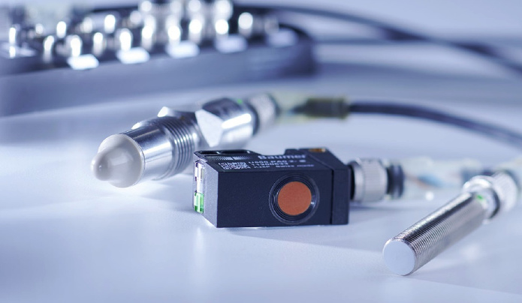
Optical Sensors
Changes in the properties of light, including absorption, emission, or reflection, are observed by optical sensors when the analyte interacts with the sensing surface.
Mechanisms:
Colorimetric sensors: They change color when a target gas or ion is present.
Fluorescent sensors: The intensity of fluorescence varies with the concentration of the analyte.
Surface Plasmon Resonance: Detects minute changes in refractive index, utilized in biomolecular interaction studies.
Advantages: High sensitivity, remote sensing capability, and immunity to electrical noise.
Example: Optical oxygen sensors employed in biomedical and environmental monitoring.
Optical Sensor

Slide 8
Mass-sensitive sensors
The working principle of mass-sensitive sensors, like QCM or microcantilever sensors, relies on the fact that the resonant frequency of a crystal changes upon adding mass to its surface.
When a chemical substance binds to the surface of the sensor, even minute changes in mass create measurable frequency shifts.
Applications:
Air pollution detection: particulates and VOCs.
Monitoring of surface adsorption in biological or chemical reactions.
Thin film deposition control in industries.

Slide 9
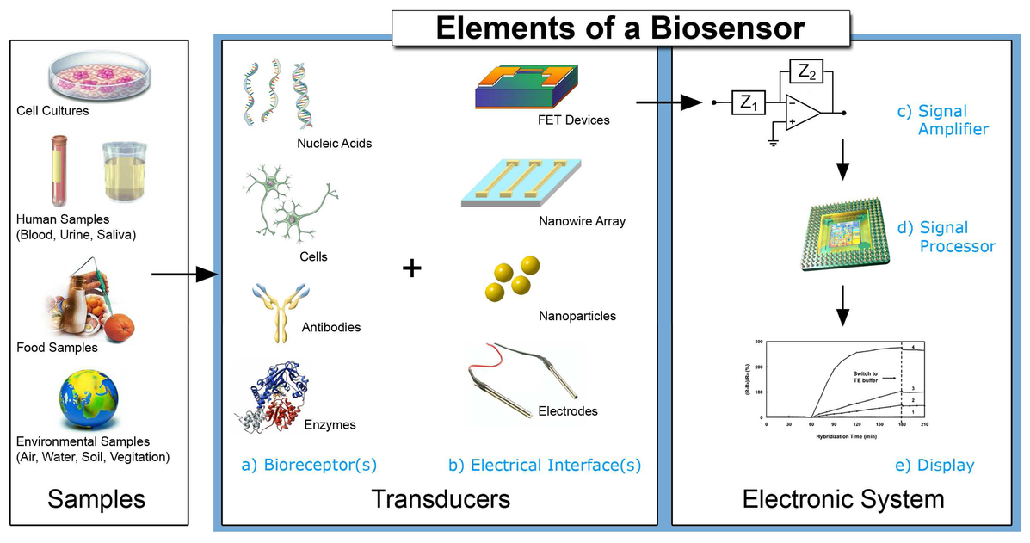
BIO SENSORS
A biosensor refers to a chemical sensor that utilizes a biological element, such as enzymes, antibodies, or DNA, for the recognition component.
Main Parts:
Biological Component: Conveys specificity;
that is, the enzyme reacts with substrate.
Transducer: Biological reaction converted to
measurable signal.
Example:
The enzyme glucose oxidase, employed by the glucose biosensor, reacts with glucose to produce hydrogen peroxide. The resulting current is proportional to glucose concentration.
Applications:
Medical diagnosis, quality control of food, and environmental monitoring.

Slide 10

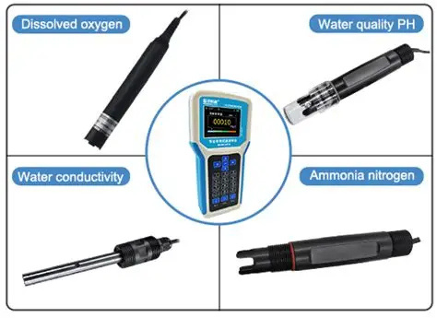
Environmental Applications
Chemical sensors are the backbone in detection and observation of environmental pollutants and the upkeep of ecosystem health. These sensors provide a key platform during environmental monitoring for the identification and quantification of hazardous materials in air, water, and soil with accuracy and speed.
Their applications are :
i) Air Quality Monitoring: It detects the presence of toxic gases like carbon monoxide (CO), nitrogen dioxide (NO₂), and sulfur dioxide (SO₂), generally emitted from vehicles and industries, which are major air pollutants.
ii) Water Quality: The collection of information about heavy metal ions (such as lead, mercury, cadmium), dissolved oxygen, and pH in water bodies helps track contamination levels and ensures appropriate management of water.
AQM
CHEMICAL SENSORS FOR WATER QUALITY

Slide 11
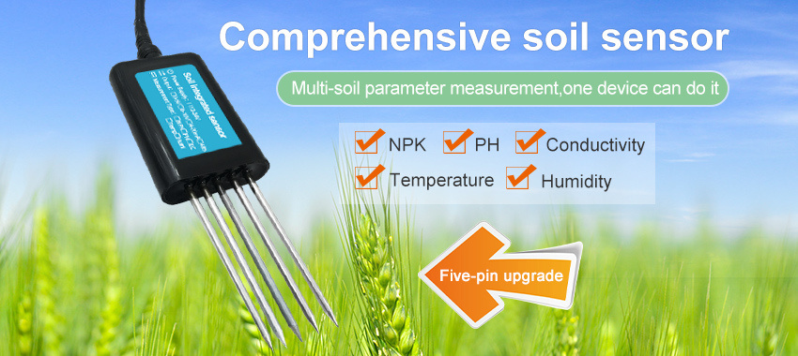
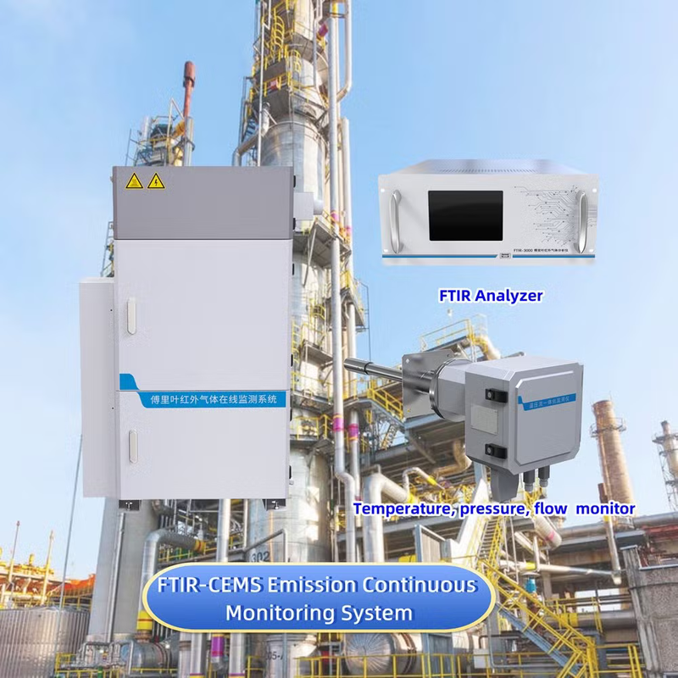
Environmental Applications
iii) Soil Contamination Studies: Measuring pesticide residues, fertilizers, and other agrochemical traces that can degrade soil health and affect crop productivity.
iv) Industrial Emission Control: Continuous real-time monitoring of industrial exhaust and effluents for compliance with environmental regulations, minimization of ecological harm.
Offering fast, on-site, and inexpensive evaluations, chemical sensors eliminate dependence on elaborate and time-consuming laboratory analyses. Chemical sensors, which can be applied to early pollution detection and environmental protection, are thus indispensable for adequate management of ecosystems in a sustainable manner.
CHEMICAL SENSORS FOR SOIL
SENSORS FOR INDUSTRIAL EMISSION CONTROL

Slide 12
Industrial and Engineering Applications
Chemical sensors are integrated into automated systems for process optimization and quality control.
Uses include:
Process Control: Concentration monitoring of chemical reactors.
Leak Detection: Gas or chemical leak detection within pipelines.
Food and Beverage Industry: Monitoring fermentation and spoilage indicators.
Petrochemical Plants: Hydrocarbon and combustion gas measurement.
They help industries to reduce waste, improve safety, and maintain consistent product quality.

Slide 13
Emerging Technologies in Chemical Sensing
1. Nanomaterials:
Advanced materials like graphene, carbon nanotubes, and metal nanoparticles enhance sensitivity, selectivity, and response time due to their high surface area and conductivity, enabling trace-level detection.
2. MEMS and NEMS Integration:
Miniaturized sensors using MEMS and NEMS are making portable and wearable chemical sensors possible, widely used in environmental and biomedical monitoring.
3. Wireless & IoT Sensors:
Integration with IoT platforms enables real-time data transmission, remote monitoring, and cloud-based analysis, improving accessibility and automation.

Slide 14
Emerging Technologies in Chemical Sensing
4. Artificial Intelligence (AI):
AI and machine learning assist in pattern recognition, noise reduction, and predictive analysis, helping sensors self-calibrate and improve accuracy over time.
5. Challenges Ahead:
Key issues include sensor fouling, long-term stability, and calibration in complex biological samples, which limit large-scale applications.
6. Smart Future:
The next generation of sensors will be self-calibrating, networked, and intelligent, driving advancements in healthcare, industry, and environmental protection.

Slide 15

Role of Engineers in Sensor Innovation
Design & Development:
The development of efficient, miniaturized low-cost chemical sensors relies on the contribution of engineers in terms of using advanced materials and technologies.
Automation & Integration:
The computer and electronics engineers integrate sensors into automated systems, IoT networks, and smart devices for real-time monitoring and control.
Data Processing & AI:
Computer engineers develop algorithms for signal analysis, calibration, and pattern recognition using AI and machine learning in order to enhance sensor accuracy and reliability.
Sustainability & Safety:
The work of the engineer guarantees that sensor systems contribute to environmental protection, industrial safety, and sustainable development by allowing early detection of pollutants and hazardous substances.
Interdisciplinary Collaboration:
Chemical, electrical, and computer engineers come together in order to bridge material science with data analytics and system design, enabling state-of-the-art technologies that are smarter, greener, and more connected.

Slide 16
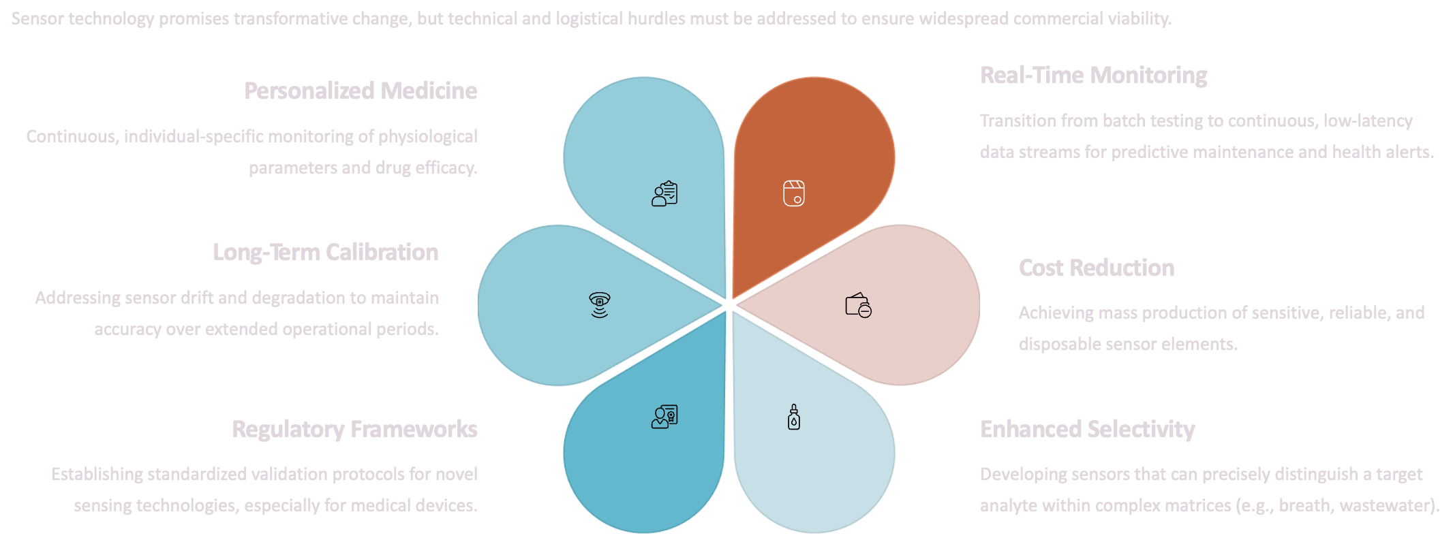
The Road Ahead for Chemical Sensing

Slide 17
References
“Chemical Sensor – Definition, Working and Types.” Wikipedia: The Free Encyclopedia. Available at: https://en.wikipedia.org/wiki/Chemical_sensor
Eggins, B. R. (2002). Chemical Sensors and Biosensors. John Wiley & Sons, UK.
“Biosensor – Principle, Types and Applications.” Wikipedia: The Free Encyclopedia. Available at: https://en.wikipedia.org/wiki/Biosensor
“Chemical Sensors: An Overview.” AZoSensors (2024). Retrieved from https://www.azosensors.com/article.aspx?ArticleID=3120
“Electrochemical Sensors Explained.” ScienceDirect Topics. Available at: https://www.sciencedirect.com/topics/chemistry/electrochemical-sensor
“Optical Chemical Sensors and Their Applications.” Nature Reviews Chemistry. Retrieved from https://www.nature.com/articles/s41570-021-00272-5
“Recent Advances in Nanomaterial-Based Chemical Sensors.” MDPI – Sensors Journal (2023). Available at: https://www.mdpi.com/1424-8220/23/5/2509
“Environmental Applications of Chemical Sensors.” ScienceDirect – Analytical Chemistry Reviews. Available at: https://www.sciencedirect.com/science/article/pii/S0925400521009125
“Wearable Biosensors for Health Monitoring.” Nature Electronics. Retrieved from https://www.nature.com/articles/s41928-022-00738-5

